Slide 1
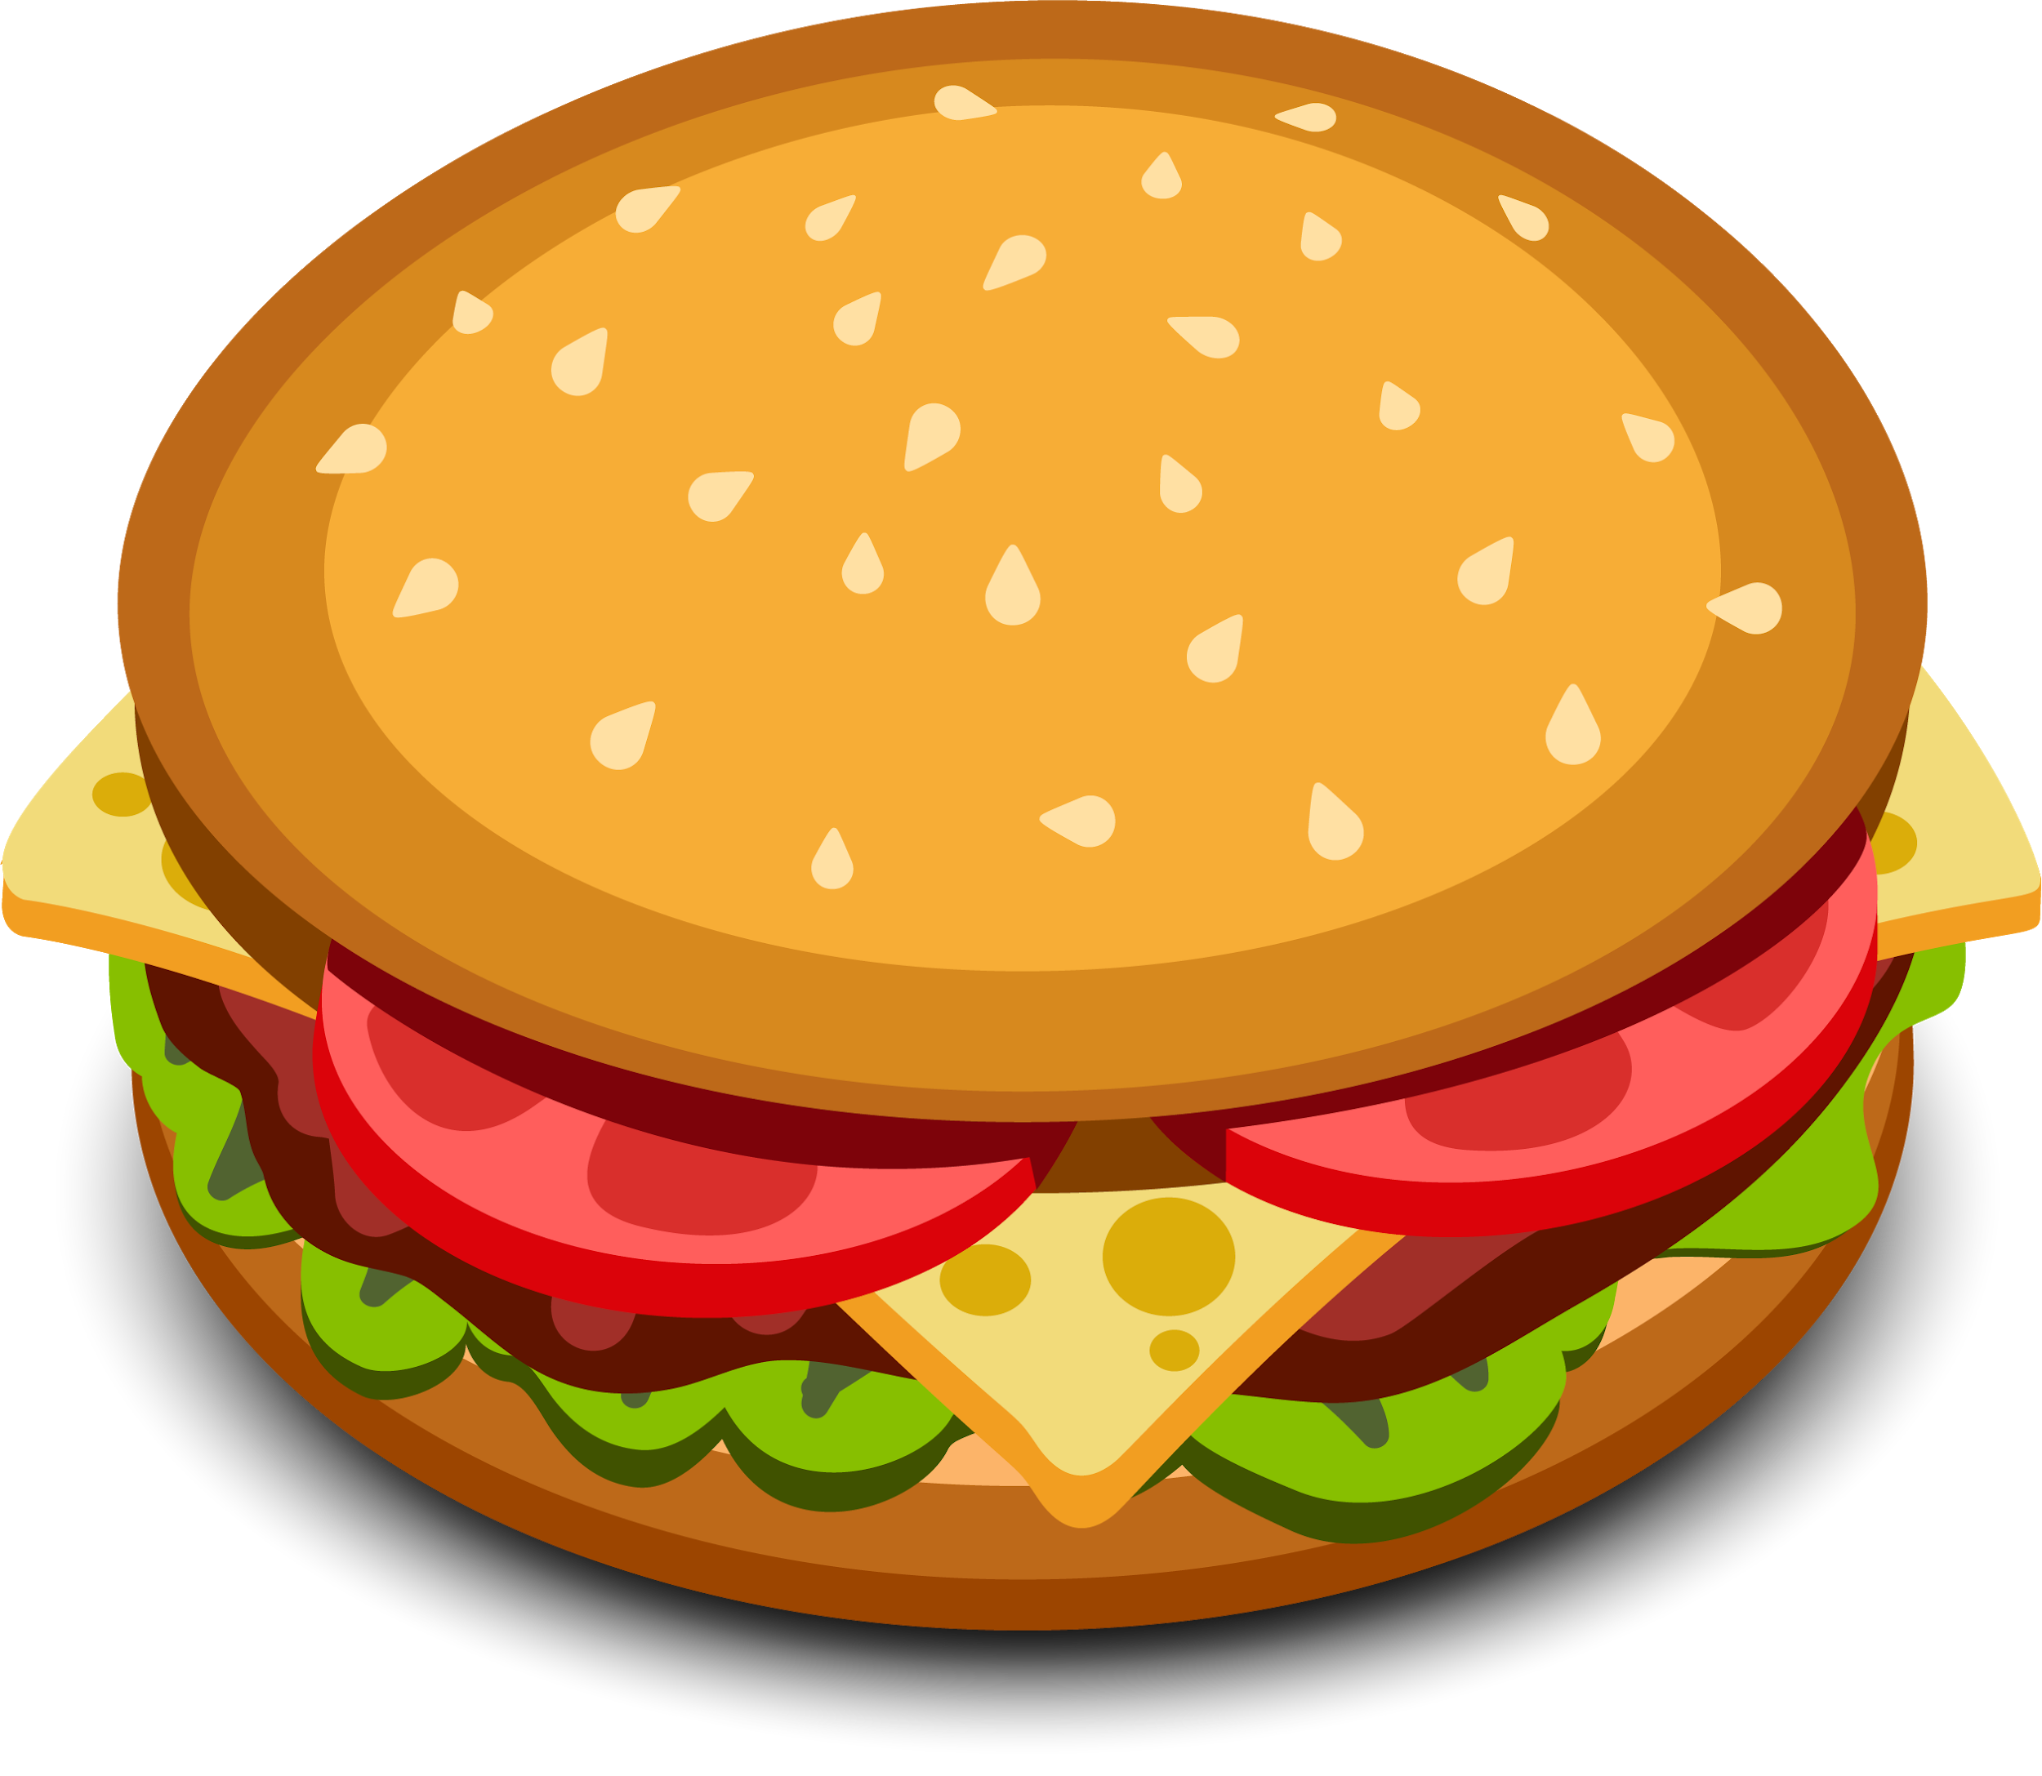
FOOD SEEKER
TEAM MEMBERS:
GUIDE:
A food recognition system
Pratham Rathore
Juhi Rastogi
Mohd Bilal
Mohd Tabrez Khan
Gunjan Radhawal
Ms. Priyanka Goel
Ohh look, it's a burger!

Slide 2
An idea
This online application enables the end users to take picture of the food, read the database and check for the label. The results, after taking food pictures will directly appear on the screen.
The app has many areas open to extensibility, from utilizing more advanced machine learning models for food recognition, adding in recommendation systems, and allowing user submitted recipes with voting and peer reviews.

Slide 3
TECHNOLOGY STACK
Android/React Native
TensorFlow
Python
Algorithms - CNN(Convolutional Neural Network)

Slide 4
PROJECT SCOPE
Food Seeker is a system that will help people to know the name and recipes of the food they take pictures of.
For the Chef it will be easier to know the recipes, it is making life easier because they don’t have to search the web for any food item they see, they can just click any picture and know the recipes.
For the personal point of view, now anyone can know to cook any dish they want whether they know its name or not.
This online application enables the end users to take picture of the food, read the database and check for the recipes.
The results after taking food pictures will directly appear in the screen.
The app has many areas open to extensibility, from utilizing more advanced machine learning models for
food recognition, adding in recommendation systems, integrating better routing and price comparisons, and
allowing user submitted recipes with voting and peer reviews.

Slide 5
GETTING STARTED
We are going to use Python and TensorFlow to write the program. TensorFlow is Deep learning framework that give control to adjust the size and weight so as to achieve optimal performance . TensorFlow have many Built-in-libraries, some are used in image classification.

Slide 6
CNN(Convolution Neural Network)
It will improve the accuracy of image classification.
Instead of feeding the entire image as array of numbers, it will broken into number of tiles, then computer tries to predict what’s picture is saying on the basis of tiles. It will help in detection regardless of where it is located.
We applied the convolutional neural network (CNN) to the tasks of detecting and recognizing food images because of the wide diversity of types of food, image recognition of food items is generally very difficult.
However, deep learning has been shown recently to be a very powerful image recognition technique, and
CNN is a state-of-the-art approach to deep learning. We applied CNN to the tasks of food detection and
recognition through parameter optimization.
CNN including a set of components (convolutional layers, pooling layers, fully connected layers, and so

Slide 7
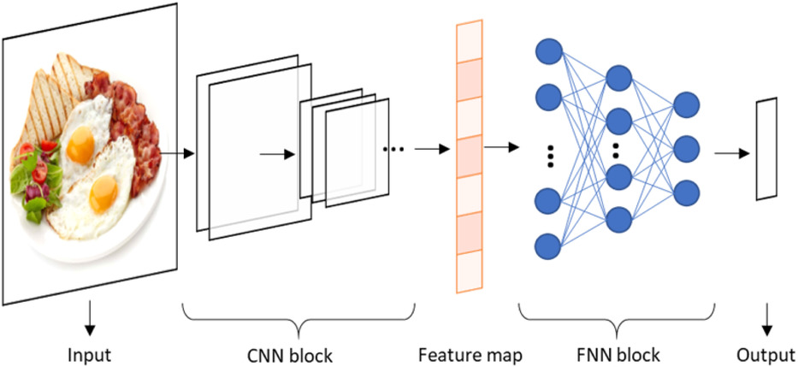
on) is currently considered as one of the most popular machine intelligence models for big data
analysis in various research areas. A typical architecture of CNN model for classification problems is
displayed in Figure

Slide 8
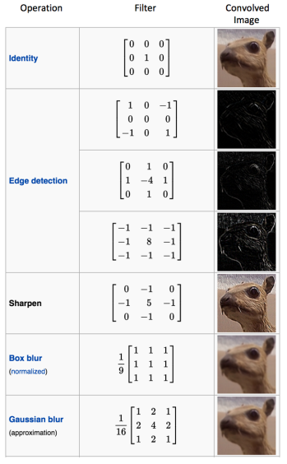
Convolution of an image with different filters can perform operations such as edge detection, blur and sharpen by applying filters. The below example shows various convolution image after applying different types of filters.

Slide 9
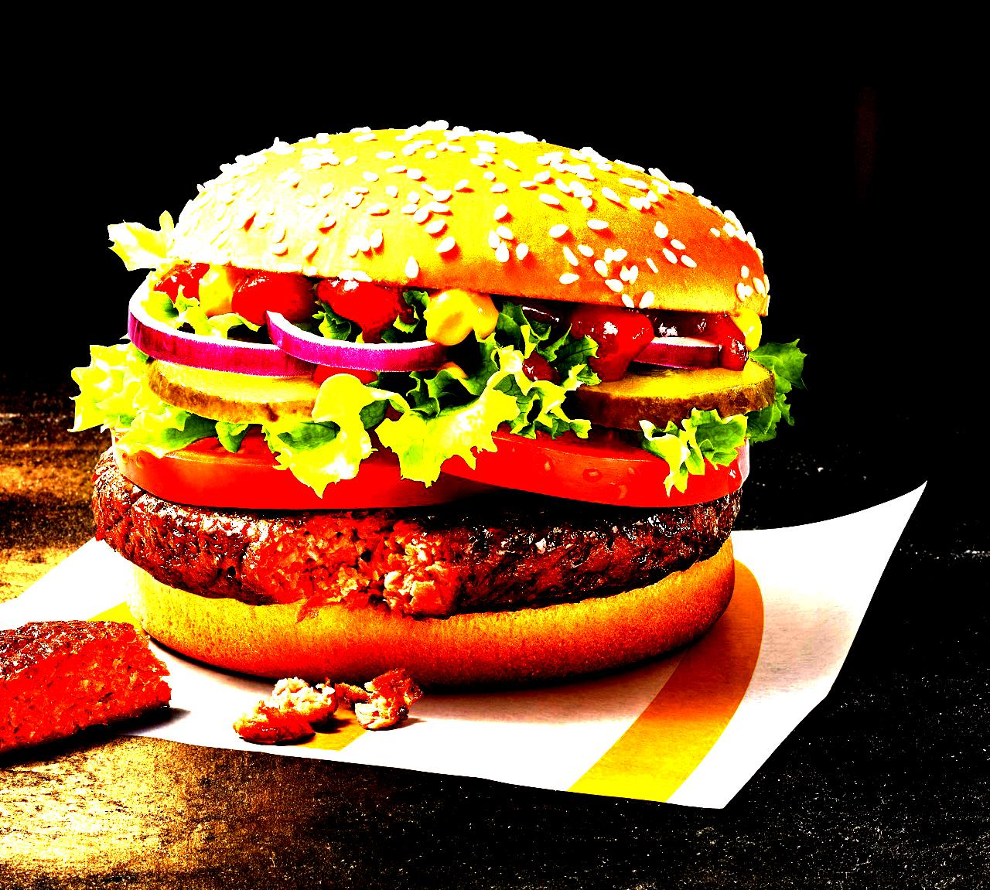
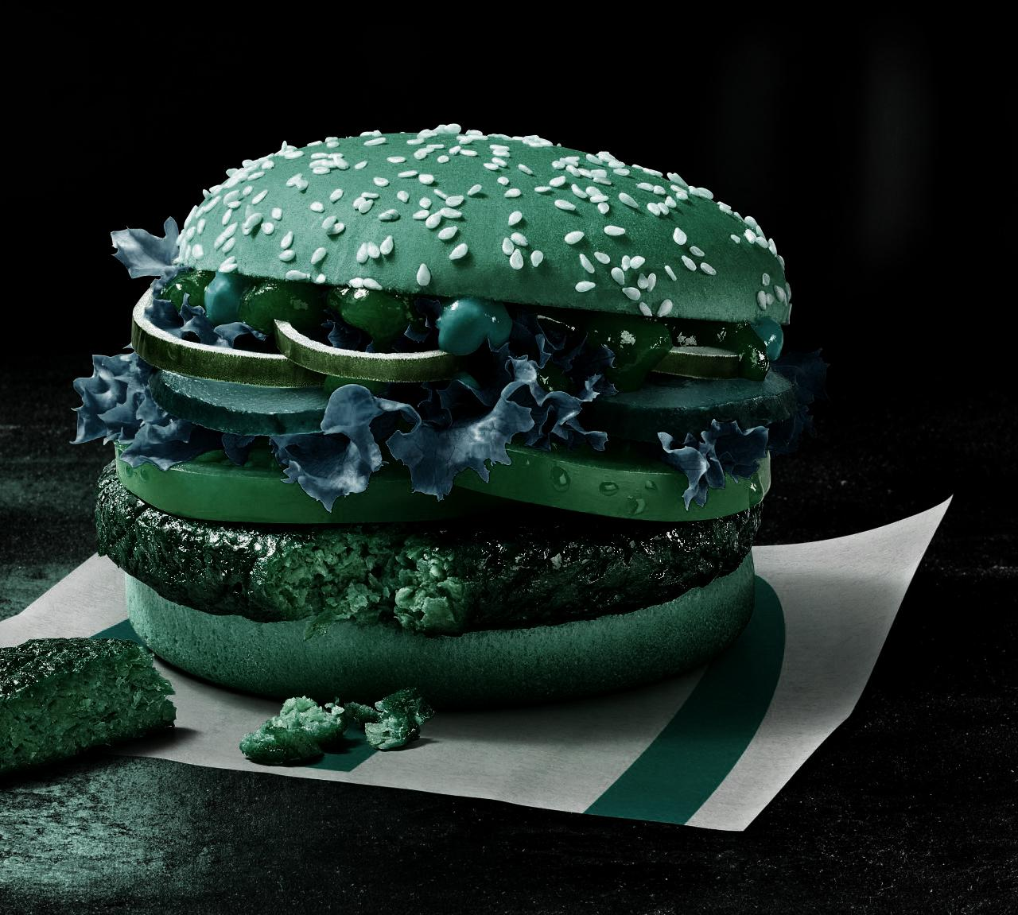
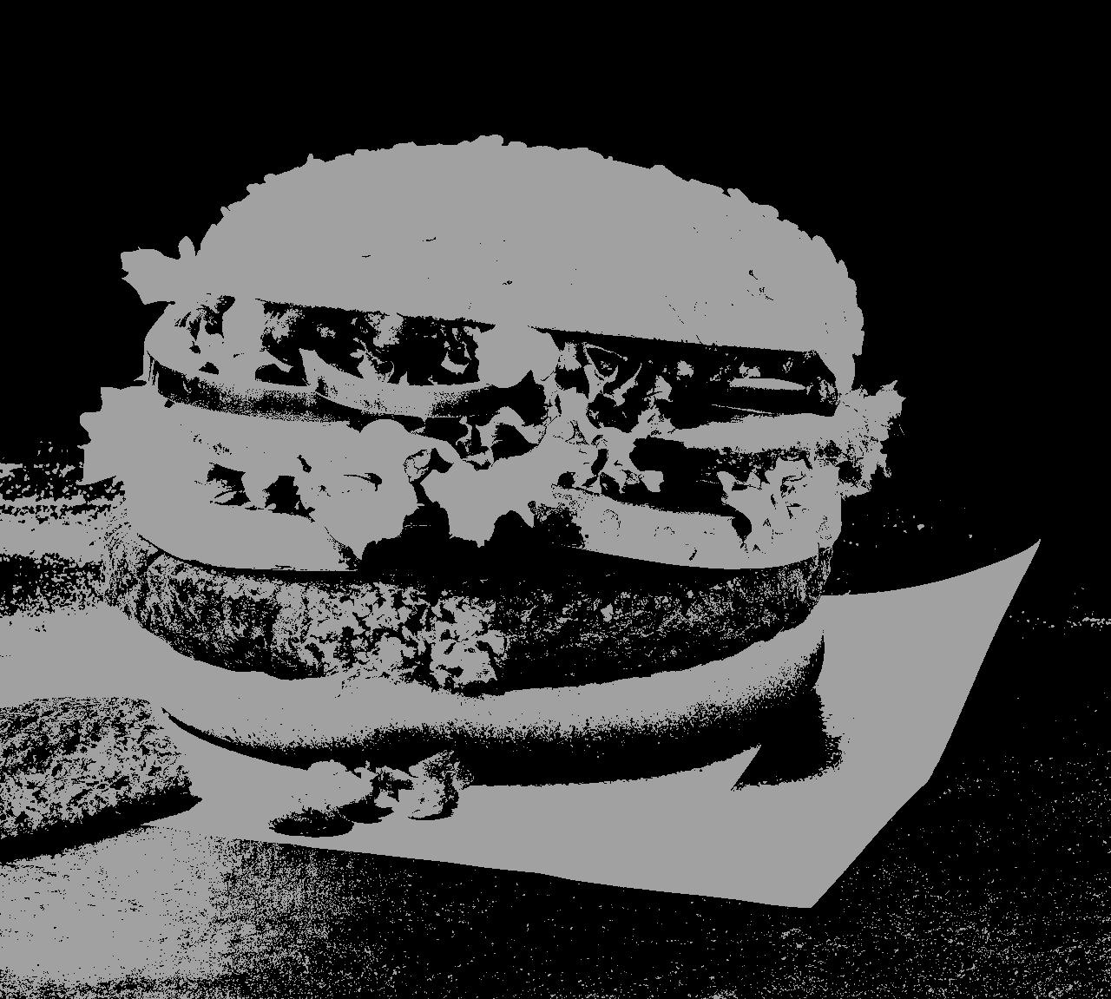
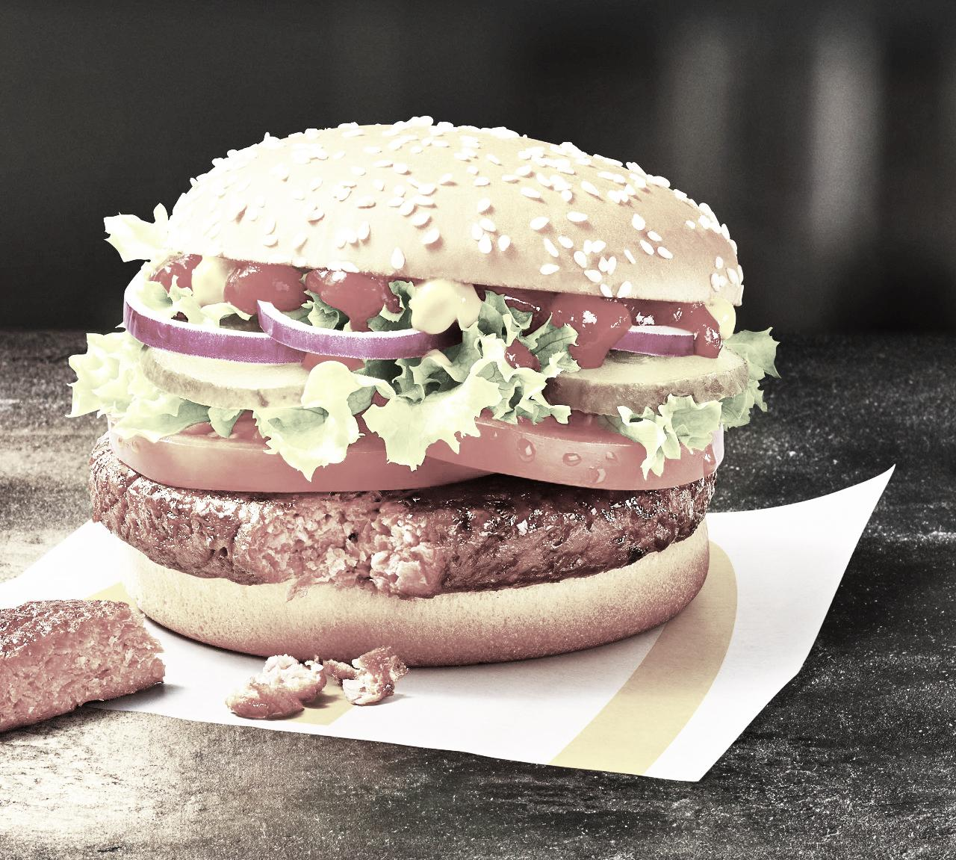

Slide 10
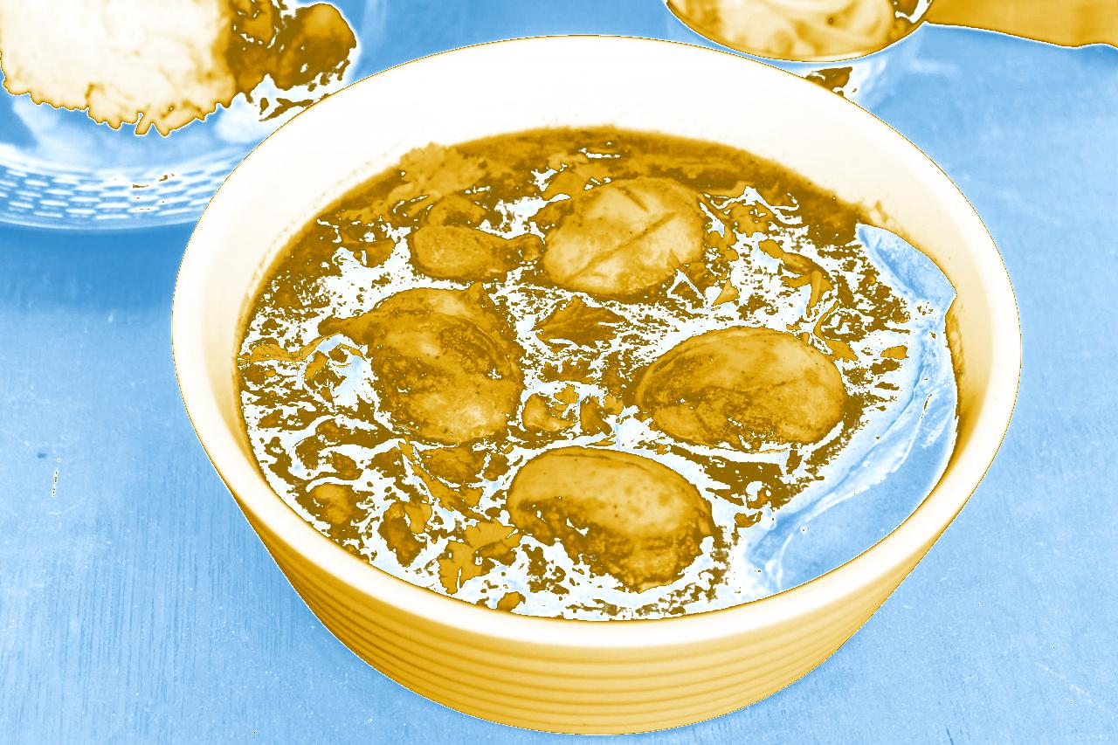
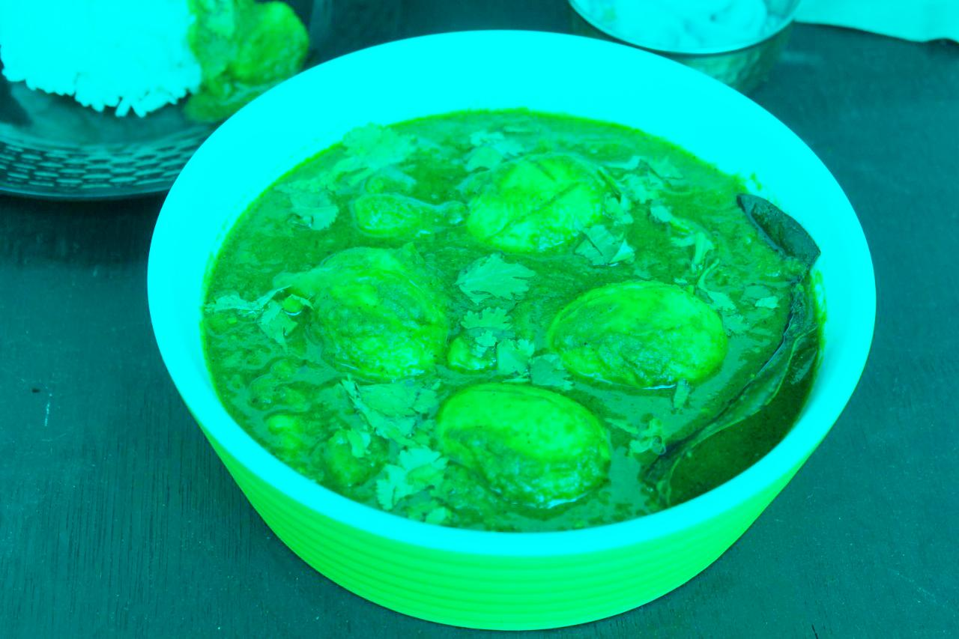
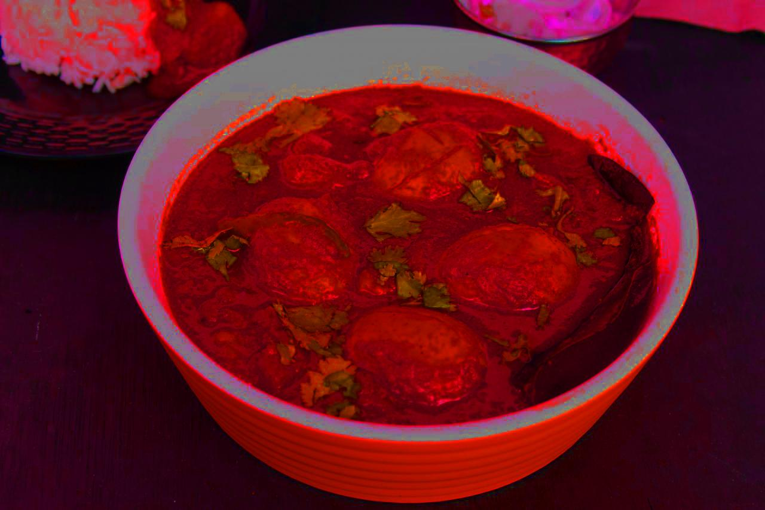
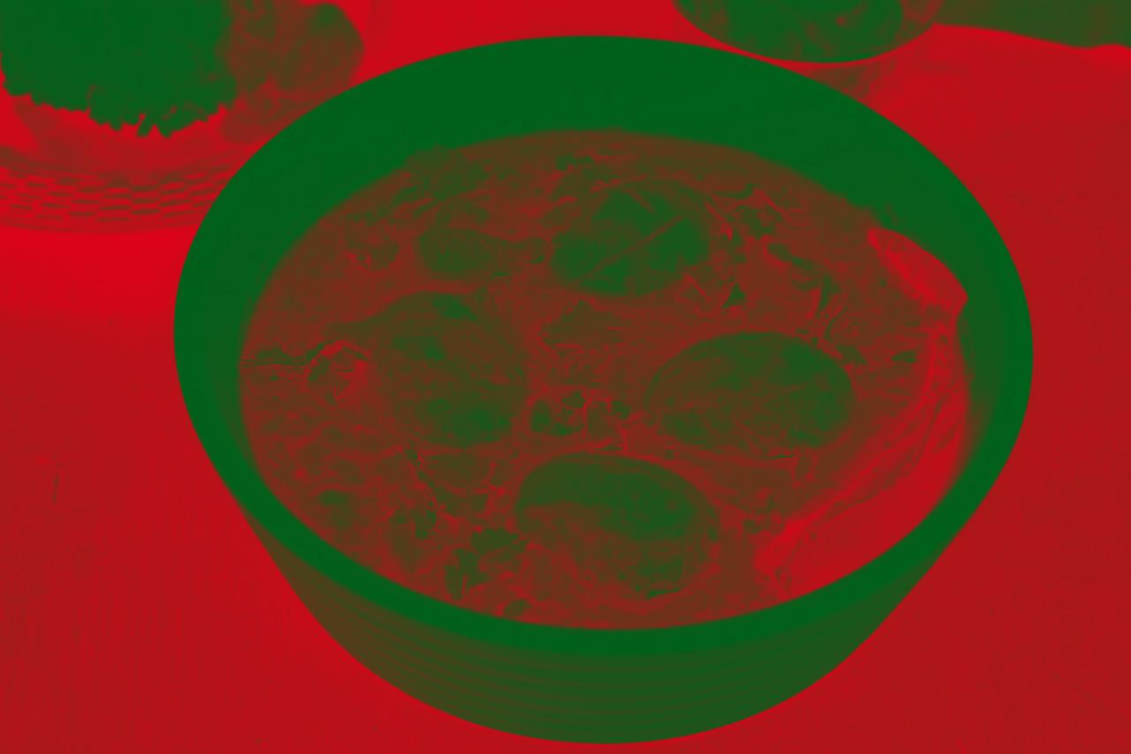

Slide 11
Food Recognition
It is a model to recognize food in a photo in summary. I have downloaded 600
photo per food on Google Image. After that, I have deleted unnecessary images and just
keep correct images. I used these images to train the model
I was trying to build an Image classifier and then following the below mentioned post I
started downloading the images of Idli, Samosa, KhammamDhokla and Dosa. I never
restricted myself in terms of number of images in a particular folder related to a
particular category I collected as much images as possible of every food category.

Slide 12
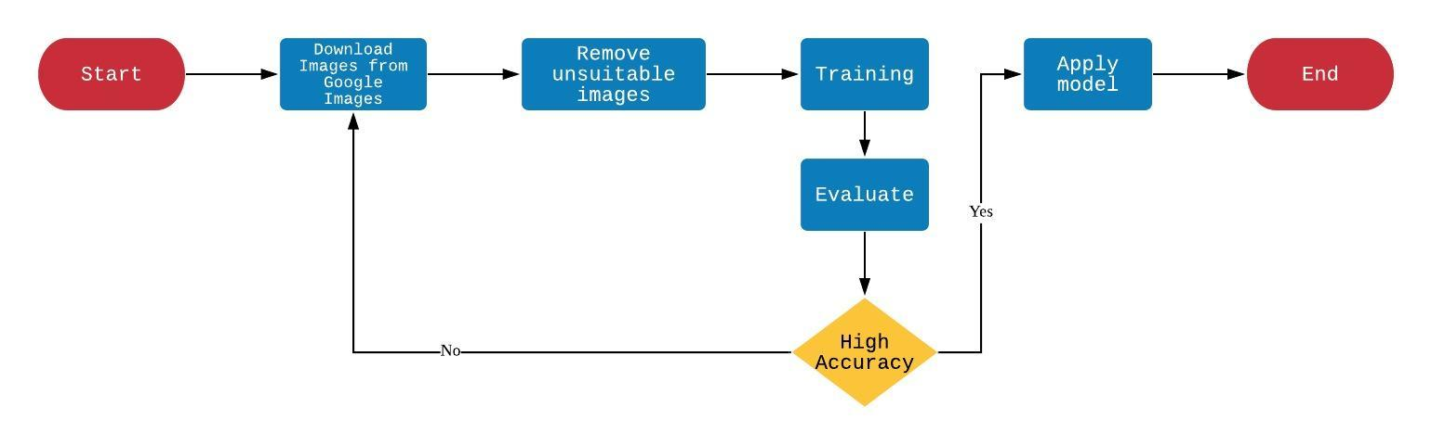

Slide 13
Dataset
We use the dataset with large number of images which are small, clearly labelled and with no noise which make it ideal for the task and take considerably less preprocessing.Some steps are followed:-
Step 1: Pre-Processing
We need the little change in the data since it already contain no noise. We’re going to add noise artificially using python to perform some operations on the data,
Step 2: Splitting our dataset
Since we cannot calculate or it will take the longer time to perform operations on such large dataset.Therefore we divide the dataset into training set and test set.
Step 3: Building a CNN
After the above two steps we can start implementing our neural network.

Slide 14
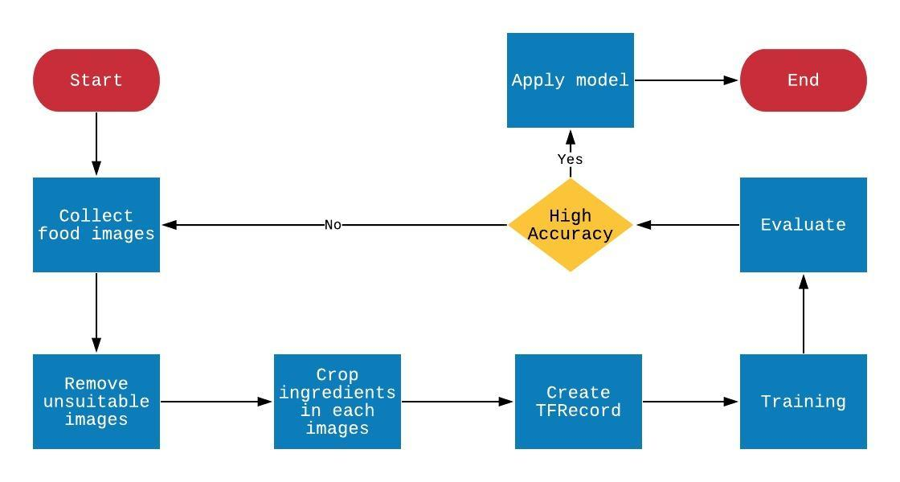
Ingredient Recognition

Slide 15
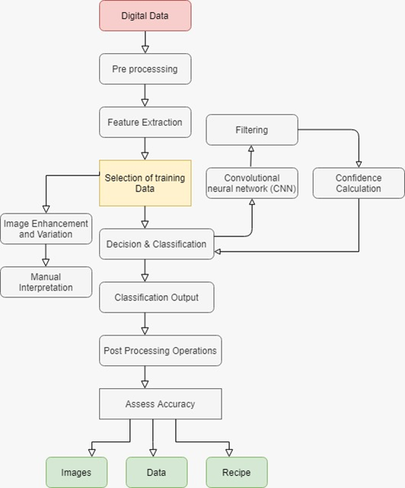
Flow Chart

Slide 16
Web Application for food recognition and detection
Firstly, we do the frontend of the application using the HTML and CSS framework. It will contain the drop box
where you can drop your food image to recognize and after pressing the analyze button you will get the details of
the image. We create this application for the ease of the user to access the application remotely and from
anywhere they want. The frontend will look like this:

Slide 17
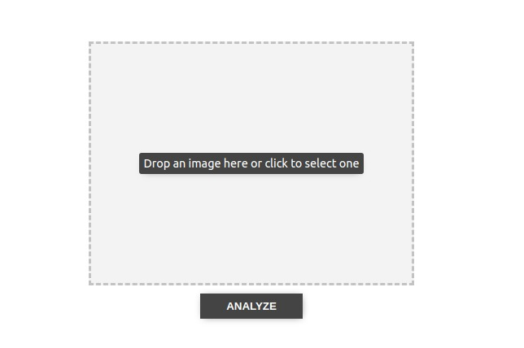
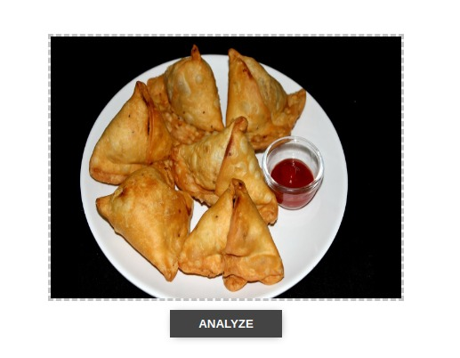
DRAG-AND-DROP

Slide 18
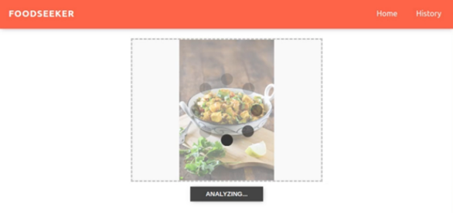
Analyzing

Slide 19
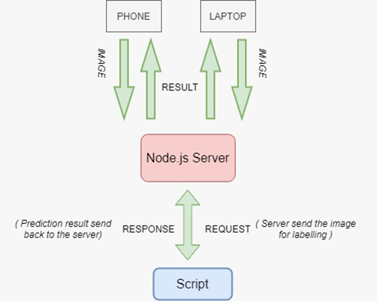
Analyzing

Slide 20
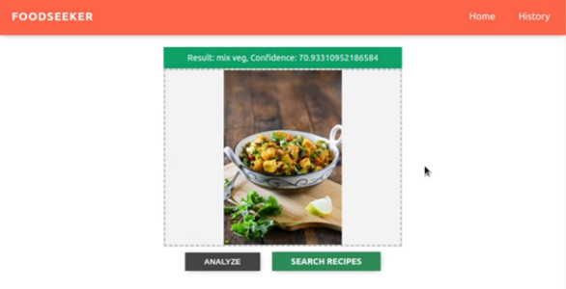
Result

Slide 21
Android application
In this we get the features or the information about the input images in the application. By this we get
information regarding the food, we recognize the meal in the picture and get the respective
recipe from it.

Slide 22
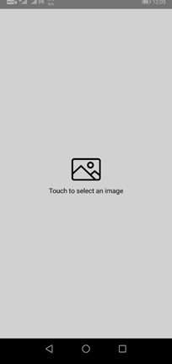
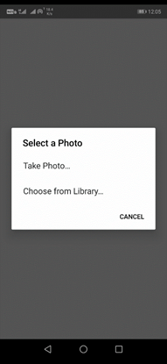
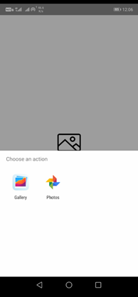
DRAG-AND-DROP

Slide 23
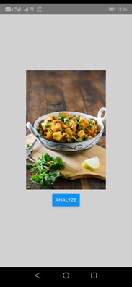
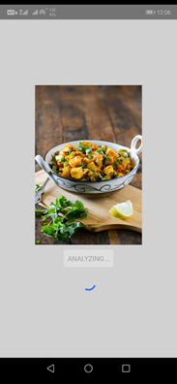
Analyzing

Slide 24
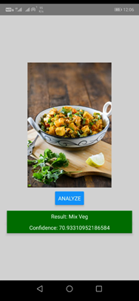
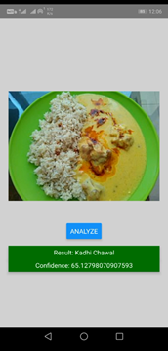
Result

Slide 25
Conclusion:
The very first step is to get the image for further processing of the image and extracting the features
from it. This method only works for a small number of food categories and is difficult to extend to large variety of composite or homemade food. The majority of their techniques for food recognition are based on
traditional signal processing techniques with hand-engineered features.

